Slide 1
Wave Optics, lecture 4, still lesson 2: Interferometric experiments
Teacher: Paul Briard
Lecture in classroom: 10:25-11:25
Then, we go in the Physics demonstration lab

Slide 2
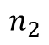
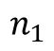
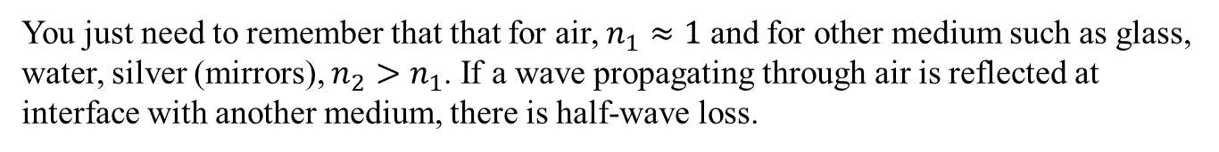
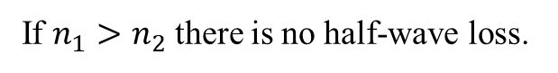
An easy way to remember if there is halfwave loss or not
$$n_{1}$$
$$n_{2}$$
If $n_{1}>n_{2}$ there is no half-wave loss.
Incident wave
Reflected wave
Transmitted wave
If $n_{1}<n_{2}$ there is half-wave loss, i,e, an extra-optical path of $\frac{λ_{0}}{2}$ for the reflected wave
You just need to remember that that for air, $n_{1}≈1$ and for other medium such as glass, water, silver (mirrors), $n_{2}>n_{1}$. If a wave propagating through air is reflected at interface with another medium, there is half-wave loss.

Slide 3
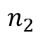
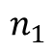
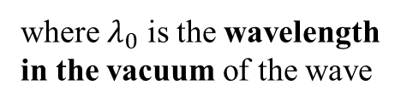
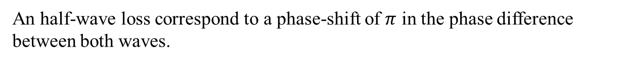
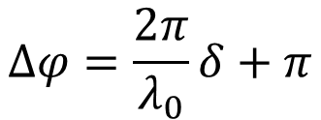
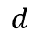
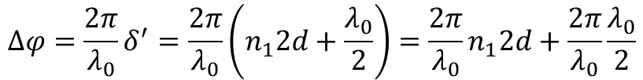
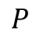
Half-wave loss due to the reflection
$$P$$
$$d$$
$$n_{1}$$
$$n_{2}$$
Phase difference between both waves at P If there is an halfwave loss:
$$∆φ=\frac{2π}{λ_{0}}δ^{′}=\frac{2π}{λ_{0}}\left(n_{1}2d+\frac{λ_{0}}{2}\right)=\frac{2π}{λ_{0}}n_{1}2d+\frac{2π}{λ_{0}}\frac{λ_{0}}{2}$$
where $λ_{0}$ is the wavelength in the vacuum of the wave
$$∆φ=\frac{2π}{λ_{0}}δ+π$$
An half-wave loss correspond to a phase-shift of $π$ in the phase difference between both waves.
Take care of this phase shift if you consider constructive and destructive interferences !

Slide 4
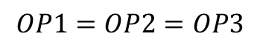
Principle of same optical path of object and images
Optical paths (OP) from A, B or C to S’:
$$OP1=OP2=OP3$$
Convergent lens
OP1
OP2
OP3
Optical path
Incident plane wave: same phase at A, B, C
If same phase at A, B, C
Same phase at S

Slide 5
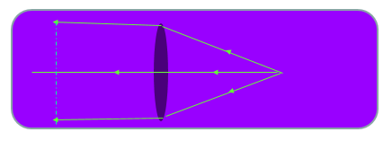
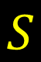
Principle of same optical path of object and images
Convergent lens
$$S$$
S is a point source on the focal plane of the lens, the 3 rays have same phase at S.
Plane of same phase: the phase is the same for A, B, C

Slide 6
Contents
Optical path and half-wave loss
Thin film interferences
Michelson interferometer
Newton’s rings
Lloyd’s mirror experiment
I skip this content in classroom and send you the powerpoint this afternoon (I will certainly do it again, at least once), even if skipped in classroom it will be a part of the homework.

Slide 7
2. Thin film interferences

Slide 8
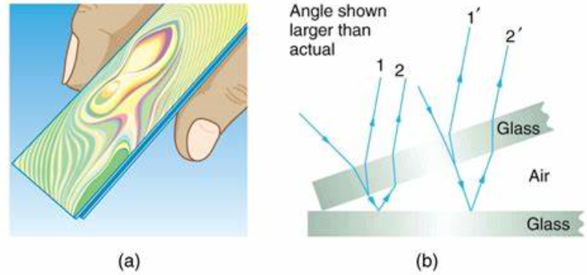
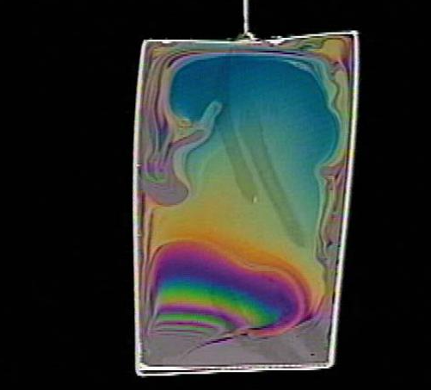
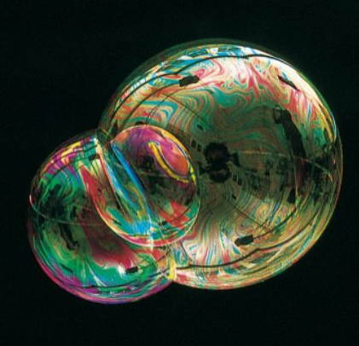
Some examples
https://opentextbc.ca/physicstestbook2/wp-content/uploads/sites/211/2017/10/Figure_28_07_02a.jpg
https://www.slideserve.com/spike/thin-film-interference-polarization
8
http://slideplayer.com/slide/8386616/

Slide 9
About thin films
The light which come from the front and the back to the film (which is also reflected) interfere together.
The color (corresponding the wavelength) depends to the thickness of the thin film

Slide 10
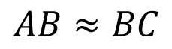
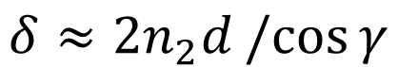
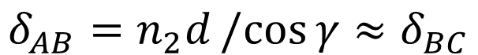
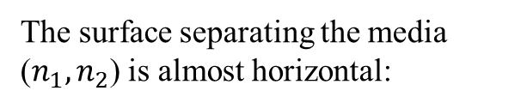
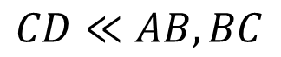
Thin film interferences with almost normal incidence
Approximations:
ray1
The surface separating the media ($n_{1},n_{2}$) is almost horizontal:
ray2
2
$$AB≈BC$$
1
If the incident light have almost normal incidence:
$$CD≪AB, BC$$
If we don’t consider possible half-wave loss, the optical path difference between both rays at C is:
$$δ=δ_{ray 1}−δ_{ray 2}=n_{2}\left(AB+BC\right)−n_{1}DC$$
Optical path from A to B, if almost normal incidence:
$$δ_{AB}=n_{2}d/cos{γ}≈δ_{BC}$$
$$δ≈2n_{2}d/cos{γ}$$

Slide 11
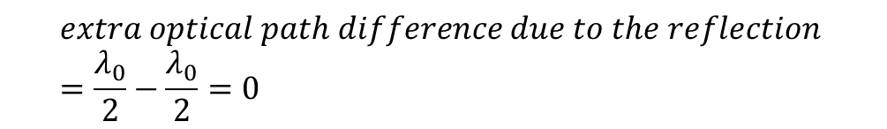
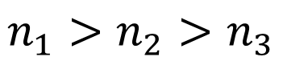
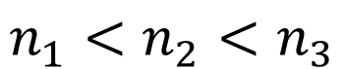
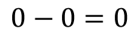
half-wave loss in thin film interferences
Optical path difference at C:
$$δ^{′}=δ+extra optical path difference due to the reflection$$
$$n_{1}<n_{2}<n_{3}$$
$$extra optical path difference due to the reflection =\frac{λ_{0}}{2}−\frac{λ_{0}}{2}=0$$
or
$$0−0=0$$
$$n_{1}>n_{2}>n_{3}$$
Extra path difference
(same half wave loss at B and C, or no half wave loss at B and C)
2
2
1

Slide 12
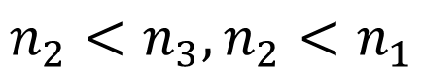
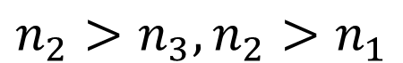
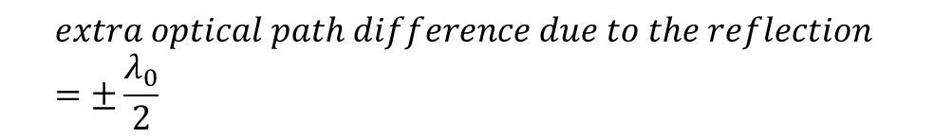
half-wave loss in thin film interferences
Optical path difference at C:
$$δ^{′}=δ+extra optical path difference due to the reflection$$
$$n_{2}>n_{3}, n_{2}>n_{1}$$
$$extra optical path difference due to the reflection =±\frac{λ_{0}}{2}$$
$$n_{2}<n_{3}, n_{2}<n_{1}$$
Extra path difference
(half wave loss at C, no half wave loss at B
OR half wave loss at B, no half wave loss at C)
2
2
1

Slide 13
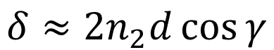
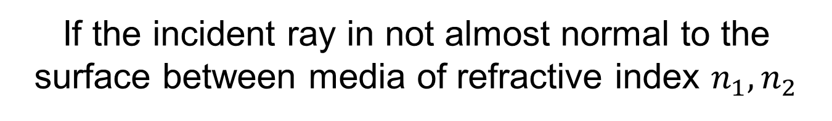
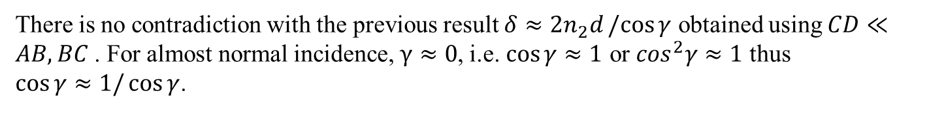
If the incident ray in not almost normal to the surface between media of refractive index $n_{1}, n_{2}$
The approximation $CD≪AB, BC$ can’t be used …
$$δ=δ_{ray 1}−δ_{ray 2}=n_{2}\left(AB+BC\right)−n_{1}DC$$
After few mathematics
$$δ≈2n_{2}d\cos{γ}$$
There is no contradiction with the previous result $δ≈2n_{2}d/cos{γ}$ obtained using $CD≪AB, BC$. For almost normal incidence, $γ≈0$, i.e. $\cos{γ}≈1$ or $\cos^{2}γ≈1$ thus $\cos{γ≈1/\cos{γ}}$.
2
2
1

Slide 14
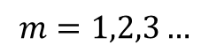
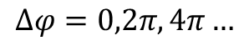
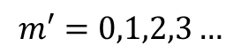
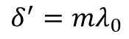
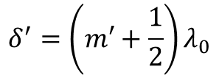
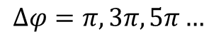
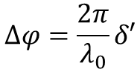
Thin film interferences
ray1
Phase difference between both wave at C:
ray2
2
$$∆φ=\frac{2π}{λ_{0}}δ′$$
1
Constructive interferences:
$$Δφ=0,2π,4π…$$
$$δ^{′}=mλ_{0}$$
$$m=1,2,3…$$
Destructive interferences:
$$δ^{′}=\left(m′+\frac{1}{2}\right)λ_{0}$$
$$m′=0,1,2,3…$$
$$Δφ=π,3π, 5π…$$
You have to consider possible half-wave loss when you describe interferences.

Slide 15
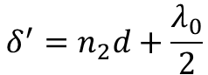
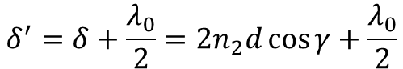
Thin film interferences
ray1
ray2
2
1
If additional half-wave loss due to the reflection:
$$δ^{′}=δ+\frac{λ_{0}}{2}=2n_{2}d\cos{γ}+\frac{λ_{0}}{2}$$
If incident light is normal to the interface $\left(i=0\right)$, then $γ=0$
$$δ^{′}=n_{2}d+\frac{λ_{0}}{2}$$

Slide 16
Thin film interferences
Another way to consider thin film interferences:
The ray 1 and the ray 2 interfere at infinite distance (they are parallel)
ray1
ray2
So, they don’t interfere …
2
1

Slide 17
Thin film interferences
Another way to consider thin film interferences:
P
EYE
L
ray1
The ray 1 and the ray 2 interfere at P: The eye is similar to a lens( cornea + eye lens) and a photo-detector (the retina).
ray2
2
1

Slide 18
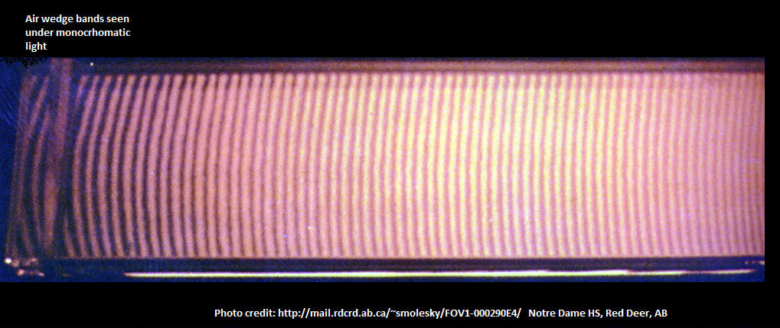
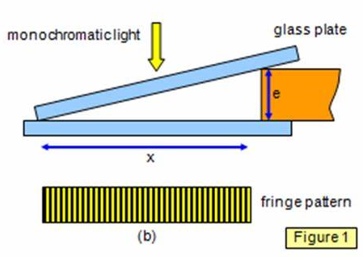
Thin film interferences
Thin air wedge separating two glass plates:
18
http://www.schoolphysics.co.uk/age16-19/Wave%20properties/Interference/text/Wedge_fringes/index.html

Slide 19
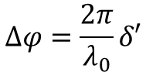
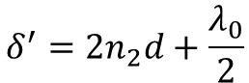
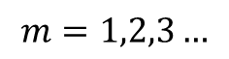
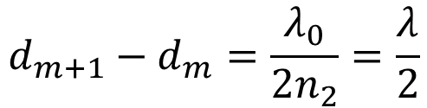
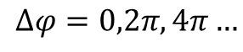
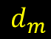



Air wedge separating two glass plates
a
Maxima and minima of light intensity
Normal incidence:
$$δ^{′}=2n_{2}d+\frac{λ_{0}}{2}$$
θ
$$d_{m}$$
$$∆φ=\frac{2π}{λ_{0}}δ′$$
Constructive interferences:
$$Δφ=0,2π,4π…$$
$$δ^{′}=mλ_{0}$$
$$m=1,2,3…$$
$$2n_{2}d+\frac{λ_{0}}{2}=mλ_{0}$$
$$d=\frac{1}{{2n}_{2}}\left(m−\frac{1}{2}\right)λ_{0}$$
Distance between two consecutive fringes:
$$d_{m+1}−d_{m}=\frac{λ_{0}}{2n_{2}}=\frac{λ}{2}$$
The distance between two consecutive fringes is the half of wavelength in the thin film.
(But here, air wedge, i.e. $n_{2}≈1$ and $λ_{0}=n_{2}λ≈λ$)

Slide 20









Air wedge separating two glass plates
a
Maxima and minima of light intensity
θ
$$d_{m}$$
$$a$$
$$\operatorname{asin}{θ}=d_{m+1}−d_{m}$$
Distance between two consecutive fringes:
$$θ$$
$$d_{m}$$
$$d_{m+1}$$
$$d_{m+1}−d_{m}=a\sin{θ}=\frac{λ_{0}}{2n_{2}}$$
$$a≈\frac{λ_{0}}{2n_{2}θ}$$
If $θ$ quite small
$$a≈\frac{λ}{2θ}$$

Slide 21
3. The Michelson interferometer

Slide 22


The Michelson interferometer
Used for the first time in the Michelson-Morley experiment from 1881 to 1887
Very important in History of Physics, it permits to show:
that the light speed don’t depends to the reference frame
that ether/luminiferous ether don’t exist (the scientists thought the light need a medium to propagate: the ether) : the light can propagate in vacuum
Michelson get the Nobel Prize of Physics in 1907
Set up of Michelson-Morley experiment (1887)
22
https://history.aip.org/history/exhibits/gap/Michelson/Michelson.html#michelson1

Slide 23

The Michelson interferometer
Interference fringes of light waves which come from the Mirrors M1 and M2
Beam splitter
Mirror
Mirror
Incident light
(can be laser light but also white light)
http://www.rmutphysics.com/charud/virtualexperiment/virtual1/Michelson/FIG13.JPG
The interference fringes depends to the orientations of the mirrors, their position, their shape …

Slide 24




The Michelson interferometer
$G_{1}$: Beam splitter
d
Optical path difference between the rays 1 and 2 (if the thickness of the beam splitter is neglected):
$$δ≈2n_{air}d$$
Refractive index of air
$$n_{air}≈1$$
$$δ≈2d$$
Interferences pattern recorded at plane P
But when interferences are involved with reflections, we must to take care of half-wave loss.

Slide 25








The Michelson interferometer
Ray 1: 1 reflection at $M_{1}$ (half-wave loss)+
1 reflection at the beam splitter (no half-wave loss)
d
Ray 2: 1 reflection at $M_{2}$ (half-wave loss)+
1 reflection at the beam splitter (half-wave loss)
Then the optical path difference between the rays is:
Reflection of ray 2 at $G_{1}$
Reflection of ray 2 at $M_{2}$
Reflection of ray 1 at $M_{1}$
$$δ^{′}=δ+\frac{λ_{0}}{2}+\frac{λ_{0}}{2}−\frac{λ_{0}}{2}$$
$$δ^{′}=δ+\frac{λ_{0}}{2}$$
$$δ^{′}≈2d+\frac{λ_{0}}{2}$$

Slide 26





The Michelson interferometer
If $M_{1}$ and ${M′}_{2}$ are parallel, the interference pattern are:
$$δ^{′}=2d+\frac{λ_{0}}{2}$$
$$d=0$$
$$δ^{′}=\frac{λ_{0}}{2}$$
destructive interferences
$$\cos{Δφ}=\cos\left(\frac{2πδ′}{λ_{0}}\right)=−1$$
$M_{1}$ and ${M′}_{2}$ could be not parallel or have different shapes
Other interference patterns

Slide 27


Some applications of Michelson interferometer
Measurement of refractive index (sample on the way to one of the beams)
Control of the quality of mirrors
Optical coherence tomography (OCT)
White light scanner to measure surfaces is a variant of Michelson interferometer
A tomographic image of biological tissue obtained from OCT interferometric patterns
https://commons.wikimedia.org/wiki/File:Phase_Shifting_and_Vertical_Scanning_Interferometry_Animation.gif
27

Slide 28


Some applications of Michelson interferometer
The Virgo and Ligo interferometers are Michelson interferometers.
They have permitted to the first detection of gravitational waves (first in 2015, confirmed in 2016)!
The gravitational waves were produced by the collision between two black holes !
VIRGO simplified principle
I don’t give more details about the Michelson interferometer, the important thing is that you understand its principle and are able to calculate a difference of optical path.

Slide 29
3. Newton’s rings

Slide 30



Newton’s rings
SPHERICAL LENS (glass)
Curved surface
AIR
$$d(r)$$
Flat surface
Glass or mirror
https://slideplayer.com/slide/5275153/
$R$: Radius of curvature of the curved surface (a lens)
$r$: distance from the axis of the lens
$d(r)$ : air thickness at distance r
(The three media can be different)

Slide 31


Newton’s rings
https://sciencedemonstrations.fas.harvard.edu/presentations/newtons-rings
Newton’s rings with incident green laser light
Newton’s rings when the wavelength is changed (numerical simulation)
31

Slide 32

Newton’s rings
Description of interferences at distance r from the axis of the lens:
Optical path difference at distance r from lens axis between
a ray which is reflected by the flat surface
and a ray which is reflected by the curved surface:
$$δ≈2n_{air}d(r)$$

Slide 33



Newton’s rings
Description of interferences at distance r from the axis of the lens:
Optical path difference at distance r from lens axis between a ray which is reflected by the flat surface and a ray which is reflected by the curved surface
$$δ≈2n_{air}d(r)$$
But there is a half-wave loss due to the reflection at the flat surface (glass A)
$$δ′≈2n_{air}d(r)+\frac{λ_{0}}{2}$$
We describe the light intensity $I(r)$

Slide 34

Newton’s rings
Newton’s rings with incident white light

Slide 35
4. Lloyd’s mirror experiment

Slide 36


Lloyd’s mirror experiment
http://berkeleyphysicsdemos.net/sites/default/files/E%2B25%2B55.gif
Lloyd’s “mirror experiment” is the name of the experiment. The mirror can be any dielectric or metal (there is no “Lloyd’s mirror”).

Slide 37
End of wave optics, lesson 2

Slide 38
Wave Optics lesson 3:Diffraction of the light
Teacher: Dr. Paul Briard

Slide 39
Contents
Huygens-Fresnel principle
The diffraction by a slit
The diffraction by a diffraction grating
The diffraction by a circular aperture

Slide 40
1.Huygens-Fresnel principle

Slide 41


Huygens principle
Every point of a wave front of a light wave can be considered as a source of secondary wavelets
In the case of the light, the wavelets are spherical waves
The resultant of the superposition of all the wavelets describe the propagation of the wave
Examples:
http://image1.slideserve.com/2450116/slide16-n.jpg
Each point of the wave front is a source of secondary waves named “wavelets”
Plane wave front

Slide 42
Fresnel principle
The wavelets interfere together
The sum of Huygens principle and Fresnel principle is named: “The principle of Huygens-Fresnel ”

Slide 43
Two main kinds of diffraction:
Fresnel diffraction (“near field” diffraction)
The light rays interfere at finite distance from the aperture
( 菲涅耳衍射 )
Fraunhofer diffraction(far field diffraction)
The light rays interfere at infinite distance from the aperture. At infinite distance from the aperture, the wave fronts of the wavelets are plane.
Fraunhofer approximation: the screen is so far from the aperture than the diffraction can be described by the Fraunhofer diffraction

Slide 44







Mathematical description of the Huygens’s principle (far field)
Electric field at P scattered by an element of surface ds of the wave front:
Normal vector to the surface of the wave front
$$\vec{n}$$
$$Q$$
$$φ$$
$$P$$
$$\vec{r}$$
Infinitesimal electric field at P from superposition of all the wavelets produced by each point of ds:
$$dE_{(p)}∝f\left(φ\right)\frac{1}{r}\text{cos}\left(ω t−\frac{2πr}{λ}+φ_{0,Q}\right)ds$$
Phase of the wave at Q, it can be omitted because it the same for all the points of the wave front
$φ$ is the angle between $\vec{n}$ and $\vec{QP}$
Distance of propagation from $Q$to $P$
“Far field” means “far from the wave front”, this can’t describe the electric field at the wave front or near

Slide 45



Mathematical description of the Huygens’s principle (far field)
Electric field at P scattered by an element of surface ds of the wave front:
Normal vector to the surface of the wave front
$$Q$$
$$φ$$
$$r$$
Electric field from superposition of all the wavelets produced by every point of the wave front:
$$E_{(p)}∝\iint{f(φ)\frac{1}{r}\text{cos}(ω t−\frac{2πr}{λ}+φ_{0,Q})}ds$$
S
You don’t have to remember this formula. It is to show you how Huygens principle is described mathematically.

Slide 46




Mathematical description of the Huygens’s principle (far field)
$$E_{(p)}∝\iint{f(φ)\frac{1}{r}\text{cos}(ω t−\frac{2πr}{λ}+φ_{0,Q})}ds$$
S
You have seen this term in the description of plane waves:
$$E_{0}\cos\left(ωt−\vec{k}.\vec{r}+φ_{0}\right)$$
But in the case of the plane wave, its amplitude $E_{0}$ is uniform (same in all space) and constant.
A point of a wave front is a source of a spherical wave which the amplitude decrease where the distance r increase.
Description of a spherical wave:
(valid everywhere excepted at the source point )
$$\frac{E_{0}}{kr}\text{cos}(ω t−\vec{k}.\vec{r}+φ_{0})$$

Slide 47
Huygens’s principle applied to light waves
P
Wavelet
Incident wave
(here a plane wave but could be different)
Aperture
The resultant electric field at P is the resultant of the superposition of each wavelets produced by each point of the wave front at the aperture.
The Huygens-Fresnel principle permits to describe the electric field (and then the light intensity ) after the aperture from the description of the incident wave at the aperture.

Slide 48


Far field diffraction of light by a circular aperture (pinhole)
https://opentextbc.ca/physicstestbook2/chapter/limits-of-resolution-the-rayleigh-criterion/
http://hyperphysics.phy-astr.gsu.edu/hbase/phyopt/cirapp2.html

Slide 49


X-rays diffraction by crystals
https://sites.google.com/a/hartdistrict.org/ms-smith/home/modern-solid-materials/chapter-11-intermolecular-forces-and-liquids-and-solids/11-5-x-ray-diffraction-by-crystals
The diffraction pattern permits to understand the structure of the crystal.

Slide 50

X-ray diffraction pattern from DNA
http://home.sandiego.edu/~cloer/bio482s06/482qanda.html
This pattern recorded by Rosalind Franklin permits to understand the double-helix structure of DNA !

Slide 51


Far field Diffraction by a slit
https://www.science20.com/standup_physicist/blog/slit_experiments_and_coherence_patterns-86322
Diffraction pattern by a slit
This pattern is quite close to what we have seen about interferences. This is because all the waves from each point of the slit interfere together, thus a diffraction pattern is an interferometric pattern. If there are two slits instead of one, more oscillations will appears on the pattern.

Slide 52

Far field diffraction by a diffraction grating
https://www.quora.com/What-is-a-diffraction-grating

Slide 53



The Fresnel diffraction (near-field diffraction)
If the screen is located quite near to the aperture, the Fresnel diffraction can be used to describe the diffraction pattern
In Fresnel diffraction, the image of the aperture can be recognizable (fringes due to the diffraction are also seen)
Image of the aperture
https://www.youtube.com/watch?v=d-MX3L7Oc7o
Fresnel diffraction pattern from a circular aperture
https://iopscience.iop.org/article/10.1088/1674-1056/26/5/054202
Fresnel Diffraction pattern from a slit
Far from the aperture, the image of the aperture can’t be recognizable

Slide 54


The Fresnel diffraction (near-field diffraction)
Fresnel Diffraction by a nut
https://www.alamy.com/stock-photo-fresnel-diffraction-by-nut-135008165.html
https://www.homedepot.com/p/Everbilt-1-2-in-Galvanized-Hex-Nut-804076/204647893
A nut

Slide 55

2.Fraunhofer diffraction by a slit

Slide 56

Cylindrical wave fronts of a wavelet from a narrow strip
$$a$$
Optical axis
Imaginary narrow strips
To understand more easily the propagation of the wave after the slit, we can see the slit as a succession of imaginary narrow strips. These imaginary strips are parallel to the slit long axis.
Each imaginary strip is a source of wavelets (Huygens’s principle: each point of the stip is a source of a spherical wavelets, the strip can be seen as a linear source of light)
The wavelets from the strips have cylindrical wave fronts (the wave front are half-cylindrical).

Slide 57


Fraunhofer diffraction by a slit
slit
$$O$$
*
$$f′$$
Fraunhofer diffraction: the wavelets interfere at infinite distance
Incident plane wave
Lens used to obtain the plane wave

Slide 58






Fraunhofer diffraction by a slit
·
$$O$$
$$a$$
*
$$f′$$
Lens
$f$: focal length of the lens
Slit width: $a=AB$
Screen
Diffraction pattern on the screen (corresponding to a slit)
The converging cylindrical lens permits to observe the diffraction pattern on the nearby screen

Slide 59






·
$$B$$
$$a$$
$$θ$$
$$θ$$
$$A$$
$$C$$
Optical axis
Optical path difference between the rays at the lower edge and at upper edge of the slit:
$$Δ=AC=\operatorname{asin}{θ}$$
Angle between the rays and the optical axis
Width of the slit
(propagation in air, $n_{air}≈1$, $Δ=n_{air}AC≈AC$, and wavelength in air $λ≈λ_{0}$)

Slide 60





The diffraction angle
$$a$$
$$θ$$
Optical axis
$$θ$$
$$θ$$
Optical axis
$$a$$
$$a$$
$$θ$$
$θ$ is the diffraction angle. It describes the direction of propagation of parallel rays (scattered in all directions) from the wave front at the slit. It is the angle between the rays and the optical axis (which is perpendicular to the slit)

Slide 61







The difference of optical path between these two rays is:
$$\frac{\operatorname{asin}{θ}}{N}$$
$$B$$
$$\frac{a}{N}$$
$$θ$$
(in this example $\frac{a}{4}$)
$$a$$
$$A$$
$$C$$
Optical path difference between the rays at the lower edge and at upper edge of the slit:
$$AC=\operatorname{asin}{θ}$$
The slit is imaginarily divided in N narrow strips. The distance between two consecutive strips (distance between their center) is
$$ΔS=\frac{a}{N}$$
The optical path difference between the waves from two consecutive narrow strips is then :
$$\frac{\operatorname{asin}{θ}}{N}$$

Slide 62











slit
·
*
$$a$$
$$θ$$
$$C$$
$$f$$
$$f′$$
We consider two narrow strips in the slit who diffract the light:
One bellow the top edge of the slit: a ray from this strip is:
One at its center. A ray from this strip is
$$θ$$
$$θ$$
The direction of the rays, relatively to the optical axis (the axis which include the center of the slit, and the center of the lenses) is described by the angle $θ$.
The optical path difference between these two rays is:
(propagation in air $n_{air}≈1$)
$$δ=\frac{a}{2}\sin{θ}$$
Right-angle triangle
$$\frac{a}{2}$$
$$θ$$
$$θ$$

Slide 63







Condition of destructive interferences
slit
·
*
$$a$$
$$θ$$
$$f′$$
$$f$$
We consider two narrow strips who are source of light:
One bellow the top edge of the slit
One at the center of the slit
The optical path difference between two parallel rays from them is:
(propagation in air $n_{air}≈1$)
$$δ=\frac{a}{2}\sin{θ}$$
There is destructive interferences between the wavelets from them at P if
$$δ=±\frac{λ_{0}}{2}$$
$$\frac{a}{2}\sin{θ}=±\frac{λ_{0}}{2}$$
$$\sin{θ}=±\frac{λ_{0}}{a}$$

Slide 64











Condition of destructive interferences
slit
Top half
$$\{$$
$$\frac{a}{2}$$
$$\frac{a}{2}$$
$$θ$$
$$\frac{a}{2}$$
Bottom half
$$\{$$
Destructive interference
between these rays
Destructive interference
between these rays
$$\frac{a}{2}\sin{θ}=±\frac{λ_{0}}{2}$$
$$\sin{θ}=±\frac{λ_{0}}{a}$$
If this condition for $θ$ is verified, the light from every strip at top half of the slit is canceled by the light of the corresponding strip in the bottom half of the slit
In a medium of refractive index $n≠1$, this condition is
$$n\frac{a}{2}\sin{θ}=±\frac{λ_{0}}{2}$$
$$\frac{a}{2}\sin{θ}=±\frac{λ_{0}}{2n}$$
But for air, n$≈1$
$$\frac{a}{2}\sin{θ}=±\frac{λ}{2}$$

Slide 65














Condition of destructive interferences
$$θ$$
$$θ$$
$$θ$$
1st quarter
1st sixth
$$\frac{a}{2}$$
1st half
2nd half
λ|2
λ|2
$$a\sin{θ}$$
$$a\sin{θ}$$
$$a\sin{θ}$$
Instead to divide the slit into two halfs, we could divide into quarters, sixths etc.
Condition of destructive interferences:
$$\frac{a}{4}\sin{θ}=±\frac{λ}{2}$$
$$\sin{θ}=±\frac{2λ}{a}$$
$$\frac{a}{6}\sin{θ}=±\frac{λ}{2}$$
$$\sin{θ}=±\frac{3λ}{a}$$
$$\frac{a}{2m}\sin{θ}=±\frac{λ}{2}$$
$$\sin{θ}=±\frac{mλ}{a}$$
$$m=1,2,3…$$

Slide 66


Condition of destructive interferences
slit
·
*
$$a$$
$$θ$$
$$C$$
$$f′$$
$$f$$
Condition of destructive interference between the parallel rays:
$$\sin{θ}=±\frac{mλ}{a}$$
This condition corresponds to the minima of intensity in the diffraction pattern
$$m=1,2,3…$$
About the sign of $θ$: The width $a$ and the wavelength $λ$ must be positive. The sign of $\sin{θ}$ has the same sign than $±m$ ($θ$ can be negative)

Slide 67









Condition of destructive interferences
Condition of destructive interferences:
$$\sin{θ}=±\frac{mλ}{a}$$
$$m=1,2,3…$$
We consider the diffraction angle $θ$ quite small to apply the approximation:
$$θ≈\sin{θ}≈\tan{θ}$$
$$\tan{θ}≈±\frac{mλ}{a}$$
If $θ$ is quite small
$$θ≈\sin{θ}≈\tan{θ}$$
$$θ≈±\frac{mλ}{a}$$
$θ$ must be expressed in radians
In Optics, where rays make a small angle $θ$ with the optical axis, the approximation “If $θ$ is quite small …” is named “paraxial approximation”, i.e. “the rays are almost parallel to the optical axis”.

Slide 68







Condition of destructive interferences
$$x$$
·
This ray pass through the center of the lens
$$θ$$
$$f$$
$$\tan{θ}≈\frac{±mλ}{a}$$
A ray which pass through the centre of the lens is not deviated. It makes an angle $θ$ with the optical axis.
$$\tan{θ}=\frac{x_{m}}{f}$$
$$\frac{x_{m}}{f}≈±\frac{mλ}{a}$$
$$x_{m}≈±\frac{mλf}{a}$$
$x_{m}$ are the x-positions for minima of intensity on the diffraction pattern

Slide 69















Condition of destructive interferences
·
This ray pass through the center of the lens
$$θ$$
$$f$$
$$x$$
$$x_{m}≈\frac{3λf}{a}$$
$$m=3$$
$$x_{m}≈±\frac{mλf}{a}$$
$$x_{m}≈\frac{2λf}{a}$$
$$m=2$$
$$m=1$$
$$x_{m}≈\frac{λf}{a}$$
$$m=1$$
$$x_{m}≈−\frac{λf}{a}$$
$$m=2$$
$$x_{m}≈−\frac{2λf}{a}$$
$$m=3$$
$$x_{m}≈−\frac{3λf}{a}$$

Slide 70



Case of rays parallel to the optical axis
All of these rays have the same optical path
$$θ=0$$
is a condition of constructive interferences between all of these rays
$$x$$
$$x=0$$
Constructive interferences
It is also a maximum of light intensity on the diffraction pattern

Slide 71





Is there constructive interferences outside the center of diffraction pattern ?
$$θ$$
The optical path difference between these two rays is:
$$\frac{a}{3}$$
$$\frac{a}{3}$$
$$\frac{2a}{3}\sin{θ}=λ$$
(constructive interferences)
$$a\sin{θ}$$
λ|2
λ|2
λ|2
But they have destructive interferences
with this ray !
$$\sin{θ}=\left(m′+\frac{1}{2}\right)\frac{λ}{a}$$
is the condition for a maxima of intensity. It is not a condition for constructive interferences between all the rays at angle $θ$.
(there is destructive interferences and constructive interferences between the parallel rays, depending to their difference of optical path)

Slide 72









Conditions for maxima of intensity
Condition for a maxima of light intensity:
$$x$$
$$\sin{θ}=\frac{3λ}{2a}$$
$$m^{′}=2$$
$$\sin{θ}=\frac{λ}{2a}$$
$$m^{′}=1$$
$$\sin{θ}=−\frac{λ}{2a}$$
$$m^{′}=1$$
$$\sin{θ}=−\frac{3λ}{2a}$$
$$m^{′}=2$$
The intensity of the maxima decrease when $m′$ increase

Slide 73

To summary the different kinds of fringes:
$$x$$
Maxima of intensity (bright fringes), constructive but also destructive interferences.
destructive interferences, minima of intensity ($I(x)=0$)
Dark fringes
Maxima of intensity and constructive interferences
Central bright fringe

Slide 74








Width of the central fringe
$$x$$
$$x_{2}≈\frac{2λf}{a}$$
$${Δx}_{m}$$
$$x_{1}≈\frac{λf}{a}$$
$$Δx_{0}$$
Using the x-position of minima of intensity
$$x_{m}≈±\frac{mλf}{a}$$
Width of the central fringe (width is defined here as the distance between two minima of intensity):
$$Δx_{0}≈\frac{2λf}{a}$$
$${Δx}_{m}=\frac{Δx_{0}}{2}≈\frac{λf}{a}$$
Width of the other fringes:

Slide 75










Width of the central fringe
I/I₀
$$x$$
$$\frac{λ}{a}→0$$
$$Δx_{0}≈\frac{2λf}{a}$$
$$Δx_{0}$$
$$Δx_{m}$$
$$Δx_{0}→0$$
$$Δx_{m}≈\frac{λf}{a}$$
$$Δx_{m}→0$$
The biggest is the width of the slit $a$, the lowest are the width of the fringes (and the weakest is the diffraction).

Slide 76










Angular width of the central bright band
$$Δθ_{1}$$
$$∆x_{1}$$
$$Δθ_{0}$$
$$∆x_{0}$$
$$f$$
slit
lens
$$∆x_{0}=2\left(f\tan{θ_{1}}\right)$$
$$Δθ_{0}≈\frac{λ}{a}$$
$$\tan{θ≈θ}$$
$$Δx_{0}≈\frac{2λf}{a}$$
The angular width of the central bright band don’t depends to the focal length $f$
$$Δθ_{m}≈\frac{λ}{2a}$$
Angular width of the other bright bands:

Slide 77






Intensity on the screen
The electric field in respect with the diffraction angle $θ$ (described the Huygens-Fresnel principle) is:
$$E_{P}≈E_{0}\frac{\sin\left(\frac{β(θ)}{2}\right)}{β(θ)/2}$$
$$β=\frac{2πa}{λ}\sin{θ}$$
where
$$I\left(θ\right)≈I_{0}{\left[\frac{\sin\left(\frac{β(θ)}{2}\right)}{β(θ)/2}\right]}^{2}$$
Then, the light intensity is:
$$\sin\left(\frac{β(θ)}{2}\right)=1$$
$$\sin\left(\frac{β(θ)}{2}\right)=0$$
Maxima of intensity for
Minima of intensity for
These results are obtained using the Huygens-Fresnel principle and not demonstrated during this lecture.

Slide 78

About the position of the slit
The change of slit position does not affect the fringe distribution on the screen .
·
$$f$$
( 单缝夫琅禾费衍射典型装置 )
The diffraction pattern on the screen is still:

Slide 79




Difference of optical path for parallel rays in case of oblique incidence
Pour gagner du temps je mets hide slide la slide suivante, et je rajouterais en exo le calcul des positions des extrema d’intensite.
$$a\sin{θ_{inc}}$$
$$θ$$
$$θ_{inc}$$
A monochromatic plane wave is incident on a single slit in oblique incidence (angle of the incident rays in respect to the optical axis is $θ_{inc}$
Difference of optical path between the upper and lower rays at the edge of the slit:
$$Δ=a(\sin{θ_{inc}}±\sin{θ})$$

Slide 80
About Fraunhofer diffraction without using a lens
slit
Il the screen is quite far from the aperture, the rays can be considered parallel and the description of the fringes is similar than previously
With the distance slit-screen instead of the focal length of the lens
screen

Slide 81
3. Diffraction by a diffraction grating

Slide 82




Introduction
http://photonicswiki.org/index.php?title=Basic_Optics_-_Outreach_Kit
https://farm1.staticflickr.com/139/431495898_f3d292e987_z.jpg
http://hyperphysics.phy-astr.gsu.edu/hbase/phyopt/phopic/cddiffract.JPG
http://www.birdspiders.com/gallery/var/resizes/Other-Invertebrates/Butterfly%2C%20Morpho%2C%20Morpho%20sp.jpg?m=1458504316

Slide 83


Two kinds of diffraction grating
Transmission diffraction grating: large number of parallel slits
Reflection diffraction grating (surface relief diffraction grating)
http://lab-training.com/wp-content/uploads/2013/10/Diffraction-Grating1.png

Slide 84





Description of transmitting grating
The grating is : periodically engraved lines of equal width and equal spacing marks on a transparent optical slide. For grating what we have called “slit” is named “lines”.
$$b$$
Width of lines
$$a$$
Distance between two adjacent lines
Grating spacing:
$$d=a+b$$
Distance between the centre of two adjacent lines
The number of lines per unit length is $m=\frac{1}{d}$
$$N=m×l=\frac{1}{d}l$$
With grating width is $l$, then the total number of lines is

Slide 85








Light intensity if only two slits
Incident plane wave
L
$$a$$
$$θ$$
P
$$d$$
$$θ$$
Slits
$$f$$
Screen
$d:$ the distance between the center of the slits
a$:$ the width of the slits
$θ:$ Angular deviation
85

Slide 86






Light intensity if only two slits
Describe the interferences between waves scattered by the slits
Describe the diffraction by a slit
$$I≈I_{0}{\left[\cos\left(\frac{φ\left(θ\right)}{2}\right)\right]}^{2}{\left[\frac{\sin\left(\frac{β(θ)}{2}\right)}{β(θ)/2}\right]}^{2}$$
$$φ=\frac{2πd}{λ}\sin{θ}$$
$$β=\frac{2πa}{λ}\sin{θ}$$
$d:$ the distance between the center of the slits
a$:$ the width of the slits
$θ:$ Angular deviation

Slide 87



Light intensity if only two slits
$${\left[\frac{\sin\left(\frac{β(θ)}{2}\right)}{β(θ)/2}\right]}^{2}$$
$$I≈I_{0}{\left[\cos\left(\frac{φ\left(θ\right)}{2}\right)\right]}^{2}{\left[\frac{\sin\left(\frac{β(θ)}{2}\right)}{β(θ)/2}\right]}^{2}$$

Slide 88

Light intensity if only two slits
$$I≈I_{0}{\left[\cos\left(\frac{φ\left(θ\right)}{2}\right)\right]}^{2}{\left[\frac{\sin\left(\frac{β(θ)}{2}\right)}{β(θ)/2}\right]}^{2}$$
Describe the interferences between waves scattered by the slits
Describe the diffraction by a slit
Maxima for single slit diffraction and interferences between wave from the slits
Maxima of interferences
Minima of single slit diffraction
Minima for interferences

Slide 89






Optical path difference between waves from adjacent slits
Wave 1
In normal incidence:
Wave 2
Incident
Plane wave
$$θ$$
d
$$θ$$
$$θ$$
l
Optical path difference between waves from adjacent slits
$$δ=nl=ndsinθ≈d\sin{θ}$$
($n≈1$)
Phase difference between the waves from adjacent slits
$$∆φ=\frac{2π}{λ_{0}}δ=\frac{2π}{λ_{0}}ndsinθ=\frac{2π}{λ}d\sin{θ}$$

Slide 90








$$θ$$
$$d=a+b$$
$$d\sin{θ}$$
$$Δφ=2π\frac{d\sin{θ}}{λ}$$
The phase difference between the waves from two adjacent slits is:
There is constructive interferences between these waves from two adjacent slits at P if
$$Δφ=±2kπ$$
$$k=0,1,2,3…$$
$$d\sin{θ}=±kλ$$
This equation is named “grating equation”
$$k=0,1,2,3…$$
is the interference order

Slide 91









Diffraction by a diffraction grating
4
$$k=0,1,2,3…$$
3
If
$$dsin θ=±kλ$$
(constructive interferences between rays 1 and 2 ) then
2
$$2dsin θ=±2kλ$$
Constructive interferences between rays 1 and 3
$$3dsin θ=±3kλ$$
Constructive interferences between rays 1 and 4
1
$$d$$
$$θ$$
$$dsin θ$$
$$2dsin θ$$
If there are constructive interferences between waves from 2 adjacent slits, there are constructive interferences between the waves which come from all the slits
$$3d\sin{θ}$$

Slide 92




Comparison of intensity profile for 2 slits and for 8 slits (single slit envelope omitted)
The waves which come from the 8 slits have the same phase
For monochromatic light (single $λ$)
8 slits
2 slits
$$k$$
$k=0,1,2,3…$ is the “interference order” where the order 0 corresponds to a diffraction angle $θ$ equal to zero

Slide 93

No sub-maxima if two slits
sub-maxima
maxima corresponding to interferences between the waves from all the slits (“principal or main maxima”)
http://www.apniphysics.com/how-to-find-laser-wavelength-using-a-diffraction-grating-in-the-lab/

Slide 94

Diffraction by a diffraction grating
Order:
-1
0
1
2 and 3 (mixed)
https://phitem.univ-grenoble-alpes.fr/formations-et-metiers/plateformes-experimentales-stages-terrain-et-experiences-en-laboratoire/enseignement-experimental/plate-forme-optique/galerie-photos?language=en
Spectrum of the light which come from a incandescent lamp, diffracted by a diffraction grating

Slide 95






Dark fringes condition (destructive interferences between waves from the slits)
The k-th order of constructive interference between the waves from all the slits occurs when the phase difference $Δφ$ for adjacent slits is $±2kπ$ ($k=0,1,2,3…$)
The dark fringe condition (destructive interference between waves from slits )occurs for
$$Δφ=±\frac{2mπ}{N}$$
$$m≠kN$$
For instance, the first minimum besides a maximum corresponding to $Δφ=2π$ occurs when:
$$Δφ=2π+\frac{2π}{N}=2π\left(1+\frac{1}{N}\right)=2π\frac{N+1}{N}$$
Here, $m=N+1$
$dφ=\frac{2π}{N}$ is the phase interval between a maximum of intensity and the first adjacent minimum

Slide 96






Dark fringes condition (destructive interferences between waves from the slits)
There is destructive interferences between waves from all the slits if the phase difference between waves from adjacent slits is:
$$Δφ=±\frac{2mπ}{N}$$
The phase difference between waves from adjacent slits is also given by:
$$Δφ=\frac{2πdsin θ}{λ}$$
$$Nd\sin{θ}=±mλ$$
$$\sin{θ}=±\frac{mλ}{Nd}$$
$$m≠kN$$
The angles $θ$ for minima of intensity are:
$$m=1,2,…N−1,N+1, …2N−1,2N+1,…$$

Slide 97








Example for 5 slits: $N=5$:
$$k=2$$
$$k=1$$
$$k=0$$
The 4 first minima correspond to:
$$m=1$$
$$m=2$$
$$m=3$$
$$m=4$$
The 4 next minima correspond to:
$$m=6$$
$$m=7$$
$$m=8$$
$$m=9$$
http://hyperphysics.phy-astr.gsu.edu/hbase/phyopt/mulslid.html
$m=5$ and $m=10$ don’t corresponds to minima

Slide 98













Explanation for the sub-maxima of intensity
There is constructive interference between rays 1 and 3 if
Example with 3 slits:
$$2d\sin{θ}=±k′λ$$
$$k^{′}=0,1,2,3…$$
$$3$$
The optical path difference between rays 1 and 2 is then:
$$d\sin{θ}=±\frac{k′}{2}λ$$
2
If $k^{′}=0,2,4 …$, there is also constructive interferences between rays 2 and 1:
1
$$d$$
$$k^{′}=0,2,4 …$$
$$θ$$
$$d\sin{θ}=0,±λ,±2λ, …$$
$$dsin θ$$
But if $k^{′}=1,3,5 …$, there is destructive interferences between rays 2 and 1:
$$2dsin θ$$
$$k^{′}=1,3,5 …$$
At positions of sub-maxima, there constructive and destructive interferences between waves from the slits

Slide 99












Maximum of intensity
$${4I}_{0}$$
Two slits interferences
$$N=2$$
$${25I}_{0}$$
Five slit interferences
$$k=−1$$
$$k=0$$
$$k=1$$
$$N=5$$
$${81I}_{0}$$
Nine slits interferences
$$N=9$$
(The single slit diffraction omitted in these graphs)

Slide 100




Maximum of intensity
$${81I}_{0}$$
Nine slits interference
The intensity of the central peak is:
$$I=N^{2}I_{0}$$
Intensity of incident light
Number of minima between two principal peaks (order $k$ and $k+1$):
$$N−1$$
Example: 8 minima if 9 slits
Number of sub-maxima between two principal peaks (order $k$ and $k+1$):
$$N−2$$
Example: 7 sub-maxima if 9 slits

Slide 101







Maximum order k
$$\operatorname{dsin}{\frac{π}{2}}=k_{max}λ$$
HIDE SLIDE pour cette annee (pas tres important, et pas ), RAJOUTER EN EXO HOMEWORK SI NON VU.
$$k_{max}=\frac{d}{λ}$$
Position of maxima corresponding of constructive interferences between waves from all the slits:
$$\operatorname{dsin}{θ}=±kλ$$
$k_{max}$ is the maximum interference order between the waves which come from all the slits
Where
$$−\frac{π}{2}<θ<\frac{π}{2}$$
$$\operatorname{dsin}{\frac{π}{2}}=k_{max}λ$$
$$k_{max}=\frac{d}{λ}$$
$k_{max}$ is the maximum interference order between the waves which come from all the slits
Number of corresponding bright fringes:
$$ΔN=2k_{max}+1=2\frac{d}{λ}+1$$

Slide 102
4. Fraunhofer diffraction by a circular hole

Slide 103



Fraunhofer diffraction by a circular hole
Fraunhofer diffraction by a single hole:
相对光强曲线
衍射屏
孔径为D
The half-angle width of corresponding to the main spot (Airy disk) is
$$φ_{0}≈1.22\frac{λ}{D}$$
爱里斑的半角宽度为
I just give you this result, without demonstrate because a bit too complicated, but please to remember it.

Slide 104


Limit of resolution of an optical instrument because of diffraction
The Airy disk appears in optical instrument because of their aperture. The resolution of the optical instruments is limited by the diffraction phenomenon (see Rayleigh criterion).
$\frac{1.22λ }{Δ}$: resolution limit of the instrument
Diameter of the diaphragm of the objective

Slide 105
Summary: About what is important to remember about the diffraction
The description optical path difference between two waves which come from two source points of an aperture.
For which condition there are constructive or destructive interferences between these waves.
You must be able to describe the diffraction pattern for a single slit.
You must to be able to find the main properties of the diffraction pattern of a diffraction grating, you must to know what is the diffraction order.
You must to know the angular half-width of the airy disk for the diffraction by a circular hole and why this limit the resolution of an optical instrument.

Slide 106
End of wave optics, lesson 2

